Slide 1
Hackathon 2025/2026 - Weekly Report
Week 1
The FIRE-HACK Project
Team 2: Ana Carolina Menoita (nº 25953), Diogo Gomes (nº 26843), João Faia (nº), Rafael Oliveira (nº 26606) and Xavier (nº 28648)
Presented by: Rafael Oliveira (nº 26606)

Slide 2
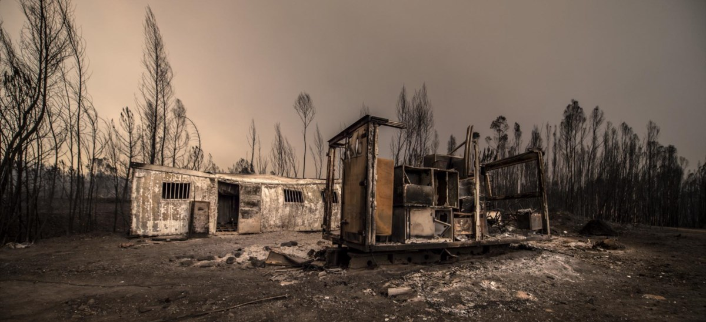
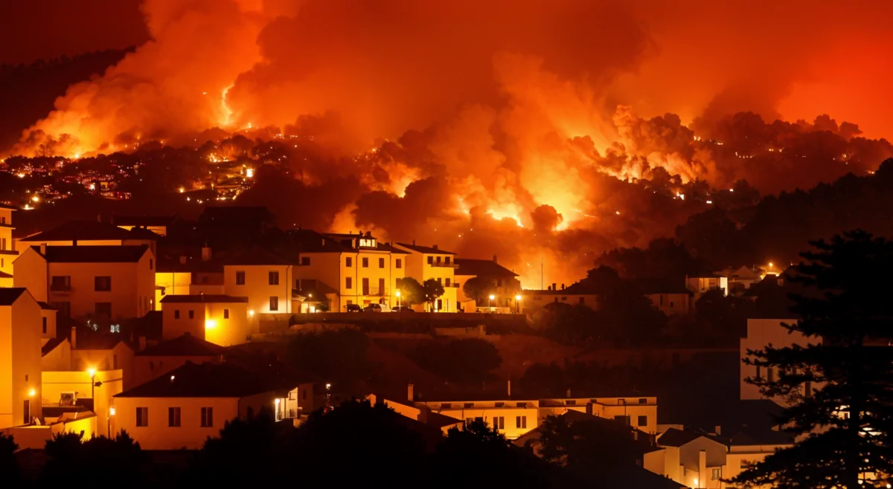
Current Paradigm
Knowledge about the highly complex phenomenon of forest fires is still limited. This is one of the reasons for the unprecedented number of deaths, destruction of homes and infrastructure, and the excessively large area of forest burned in recent years.

Slide 3
The FIRE-HACK Project
It aims to better understand and predict the behaviour of fires, how they depend on fuels, topography and the weather.
To plan mitigation actions;
To protect significant areas and reduce risk;
To delineate alert and evacuation plans;
To define the deployment of resources for wildfires;
To dictate post-fire recovery actions.

Slide 4
The FIRE-HACK Project
1. To create a comprehensive high-quality fire behaviour data set
2. To characterize the relations between the environmental drivers and the fire behaviour
3. To define the how the fire behaviour relates to their impacts, namely fire suppression effectiveness and burn severity
4. To effectively disseminate this new-found knowledge

Slide 5
The FIRE-HACK Project
1. To create a comprehensive high-quality fire behaviour data set
2. To characterize the relations between the environmental drivers and the fire behaviour
3. To define the how the fire behaviour relates to their impacts, namely fire suppression effectiveness and burn severity
4. To effectively disseminate this new-found knowledge

